Slide 1
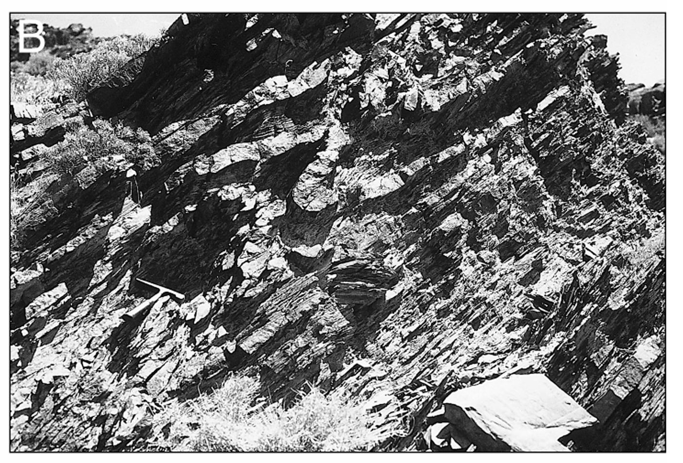
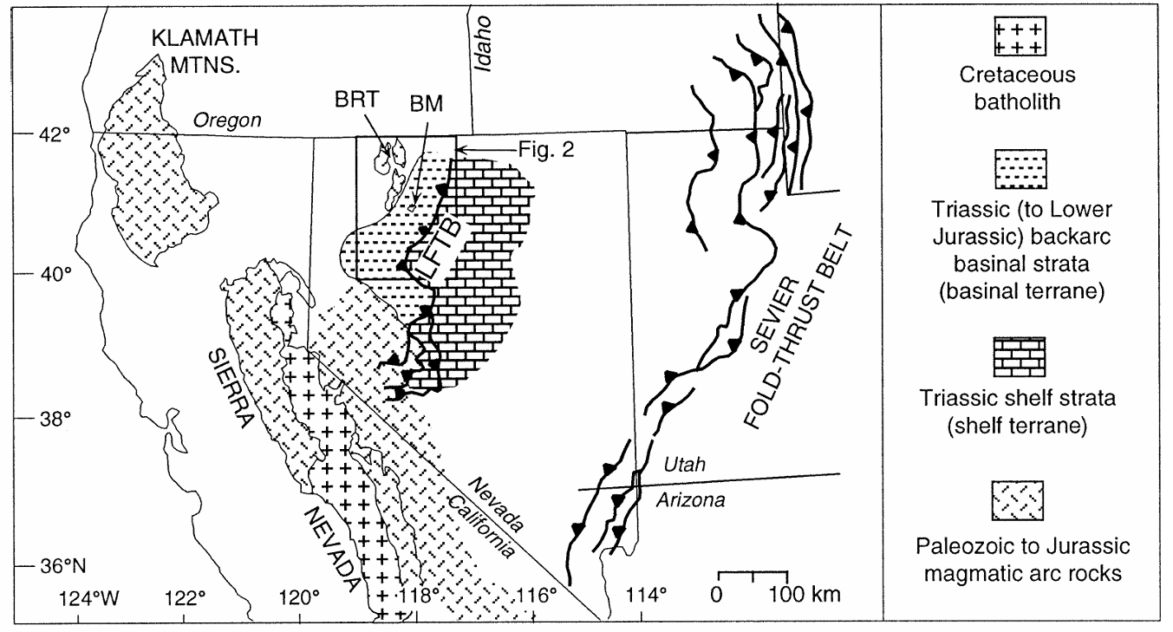
Structural Evolution of a Mesozoic backarc fold-thrust belt (Luning-Fencemaker Thrust Belt)
Wyld, 2002
Ryan Parkyn

Slide 2
Study area: Blue Mountains and the Luning Fencemaker Thrust Belt
Motivation: North LFTB poorly studied
No stratigraphy documented
No detailed maps
400 km long fold thrust belt

Slide 3
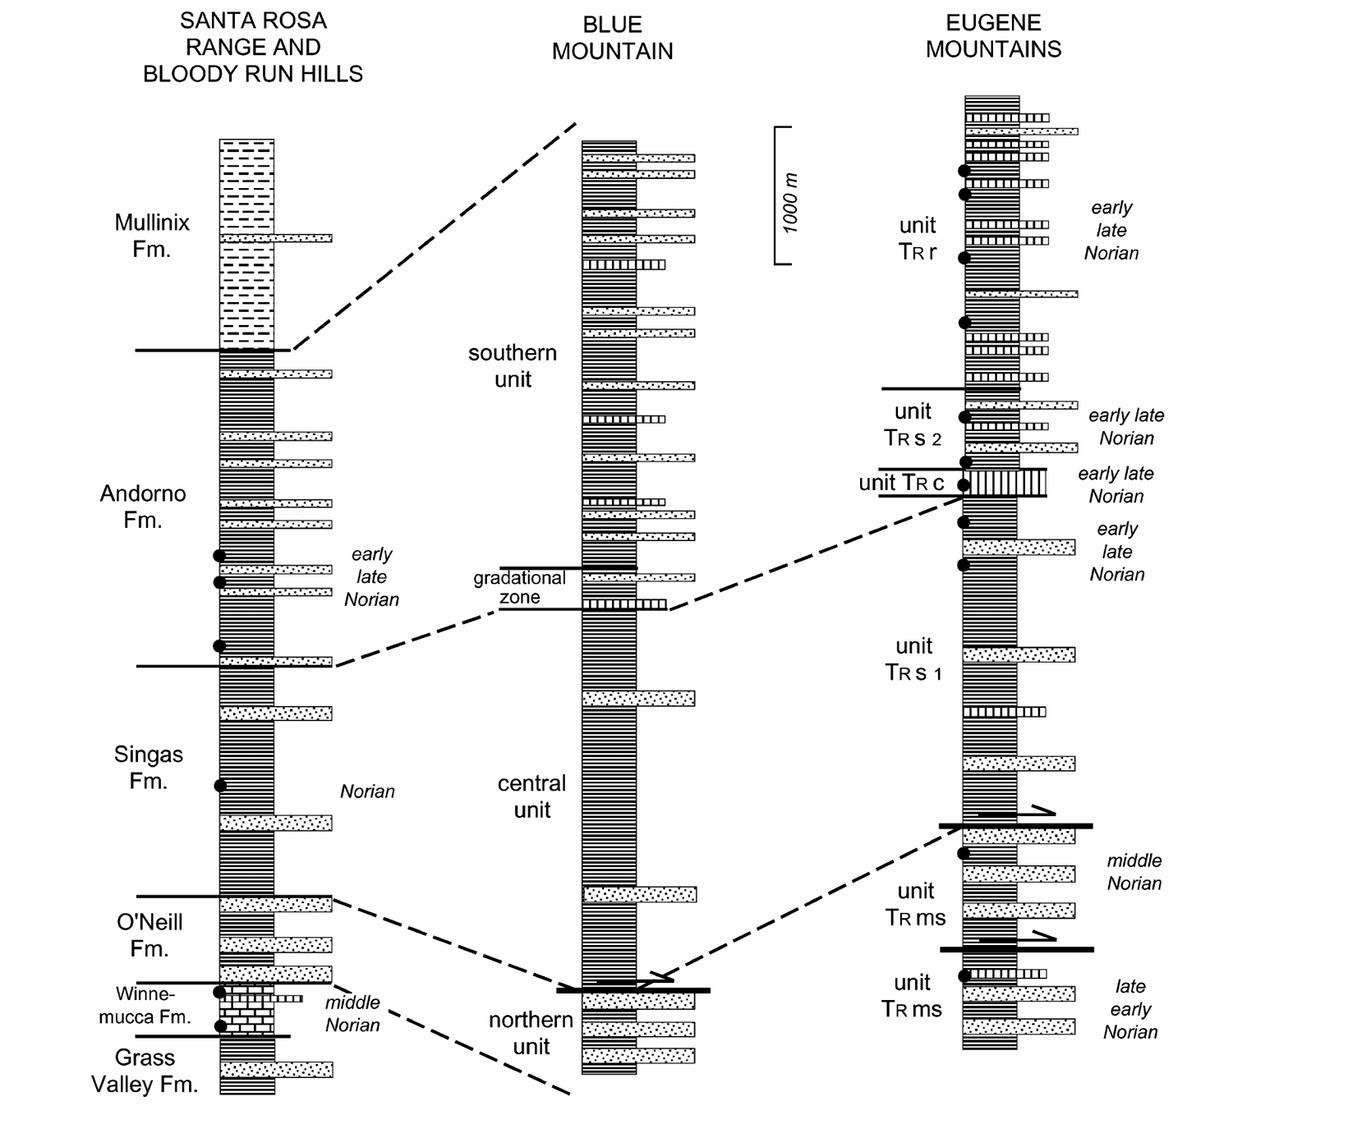
Stratigraphic Correlation in Blue Mountains.
Mapping was not possible before correlation

Slide 4
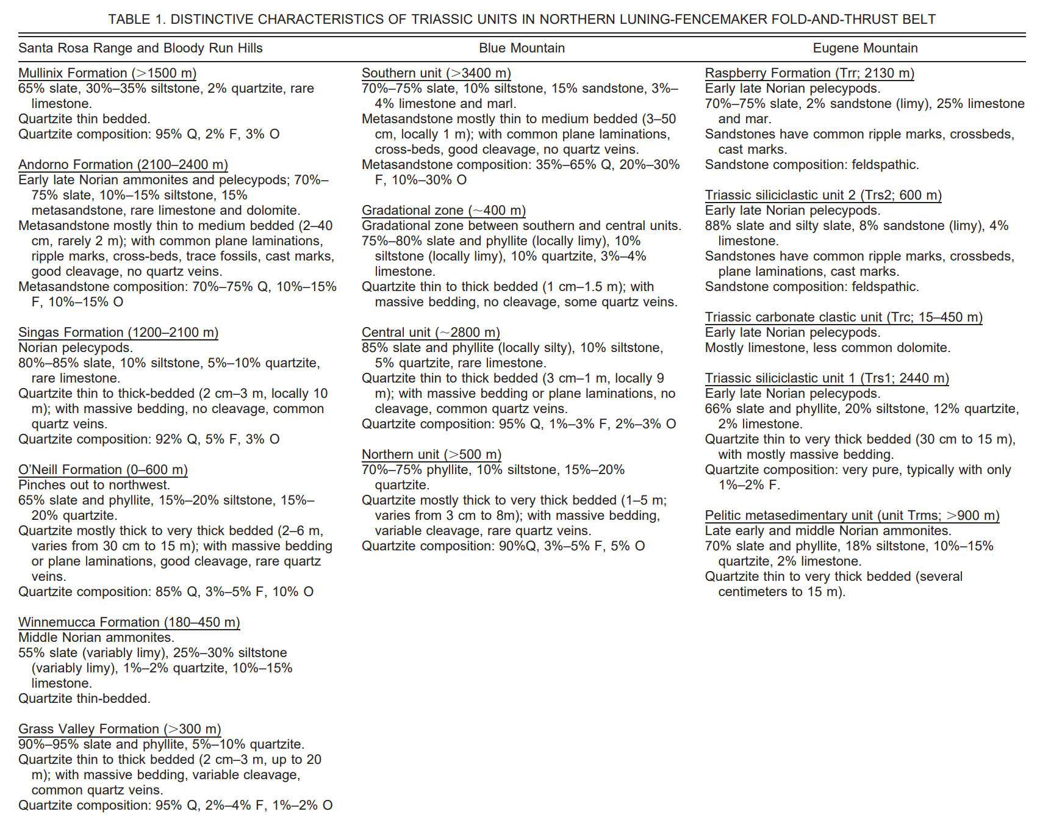

Slide 5
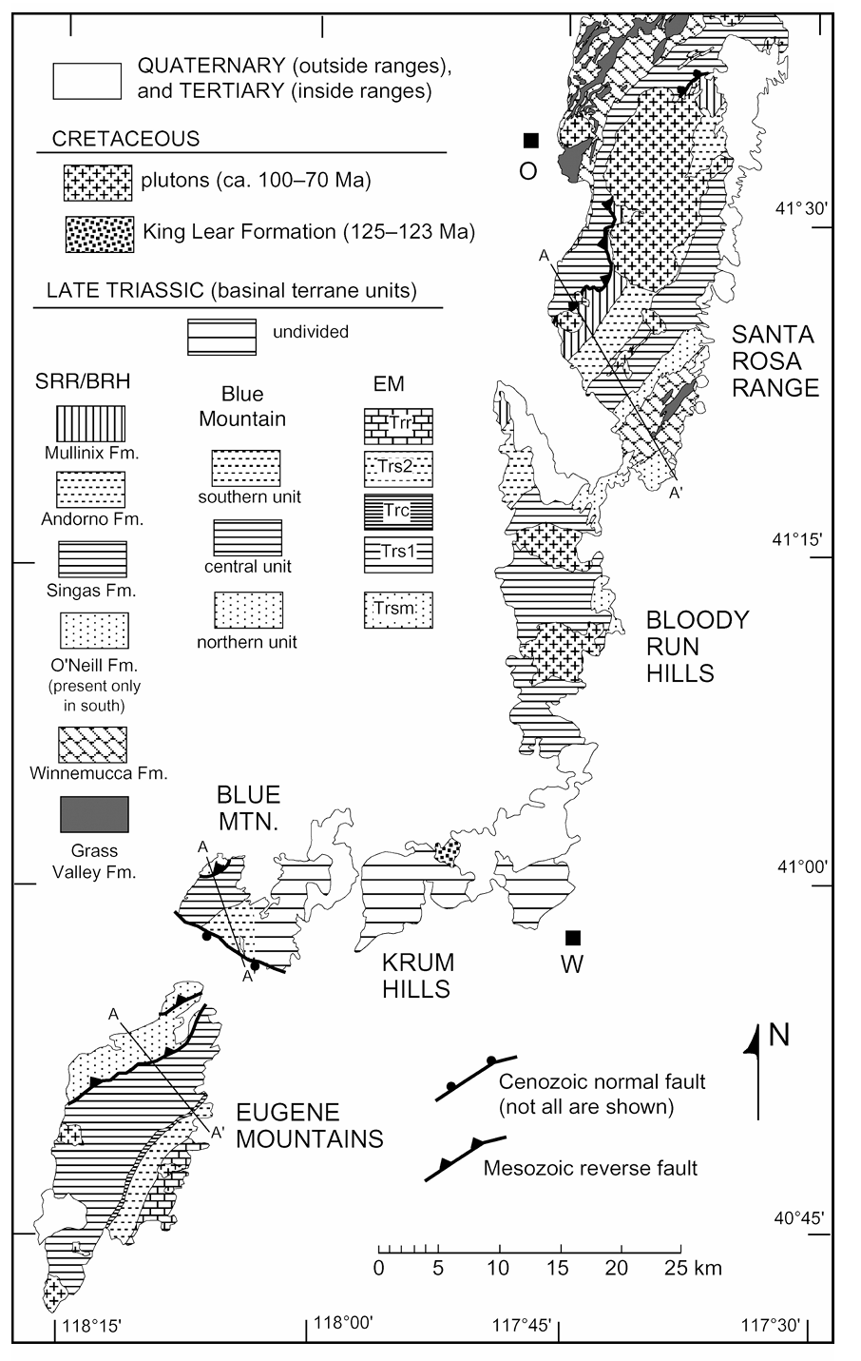
Stratigraphic correlation in Blue Mountains with surrounding areas.
Mapping was not possible before correlation

Slide 6
Deformation features in Blue Mountains
1st phase called D1
Cleavage development S1: mostly in metashales defined by metamorphic muscovite + chlorite
^ Low grade metamorphism <400C
Folds of F1: vary in size btw ~15cm to >50m tight to isoclinal
Main Reverse Fault
Qtz veins appear only in fractured quartzites reflecting brittle rheology compared to surrounding slates. Increase strain near thrust

Slide 7
Stereonet D1 features in Blue Mountains
These features show NW-SE Shortening
Deformation responsible for 55-75%

Slide 8
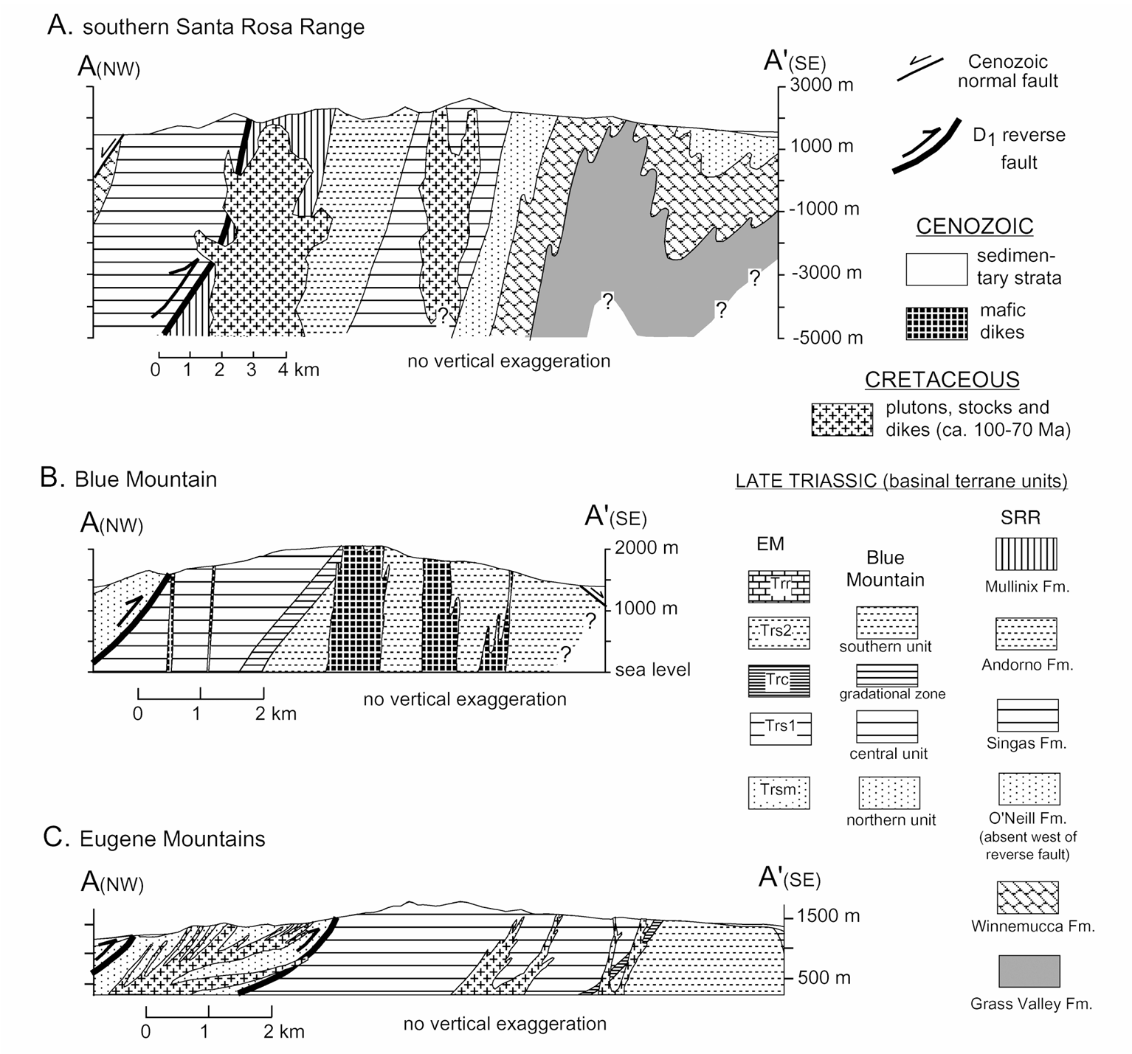
Main phase of deformation recorded across multiple surrounding mountains

Slide 9
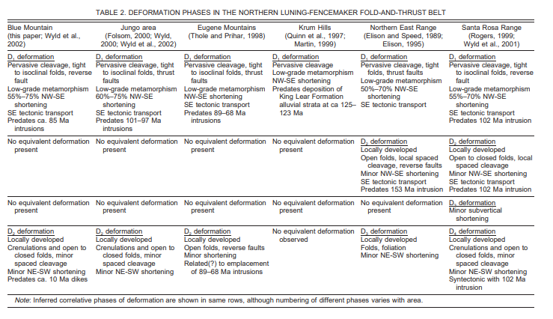
Other phases of deformation
D2 Deformation: F2 Folding (open), crenulation cleavage > pressure solution, low temp, no metamorphic mineral growth
NE-SW shortening of <5%
Widespread late cretaceous igneous suites: mafic does + plutonism (Ar-Ar ages)

Slide 10
Interpretation of what deformation at Blue Mountains records

Slide 11
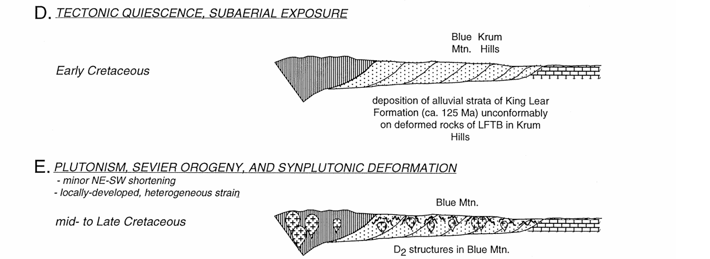
Interpretation of what deformation at Blue Mountains records

Slide 12
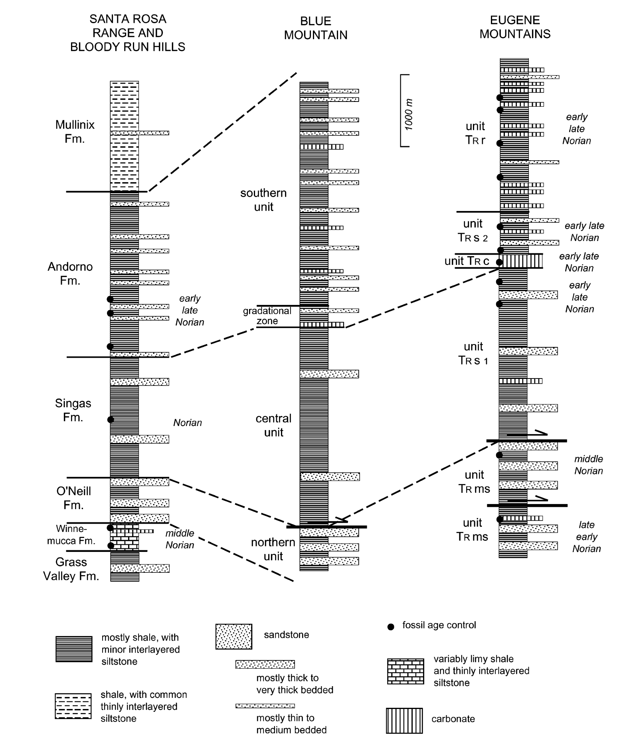
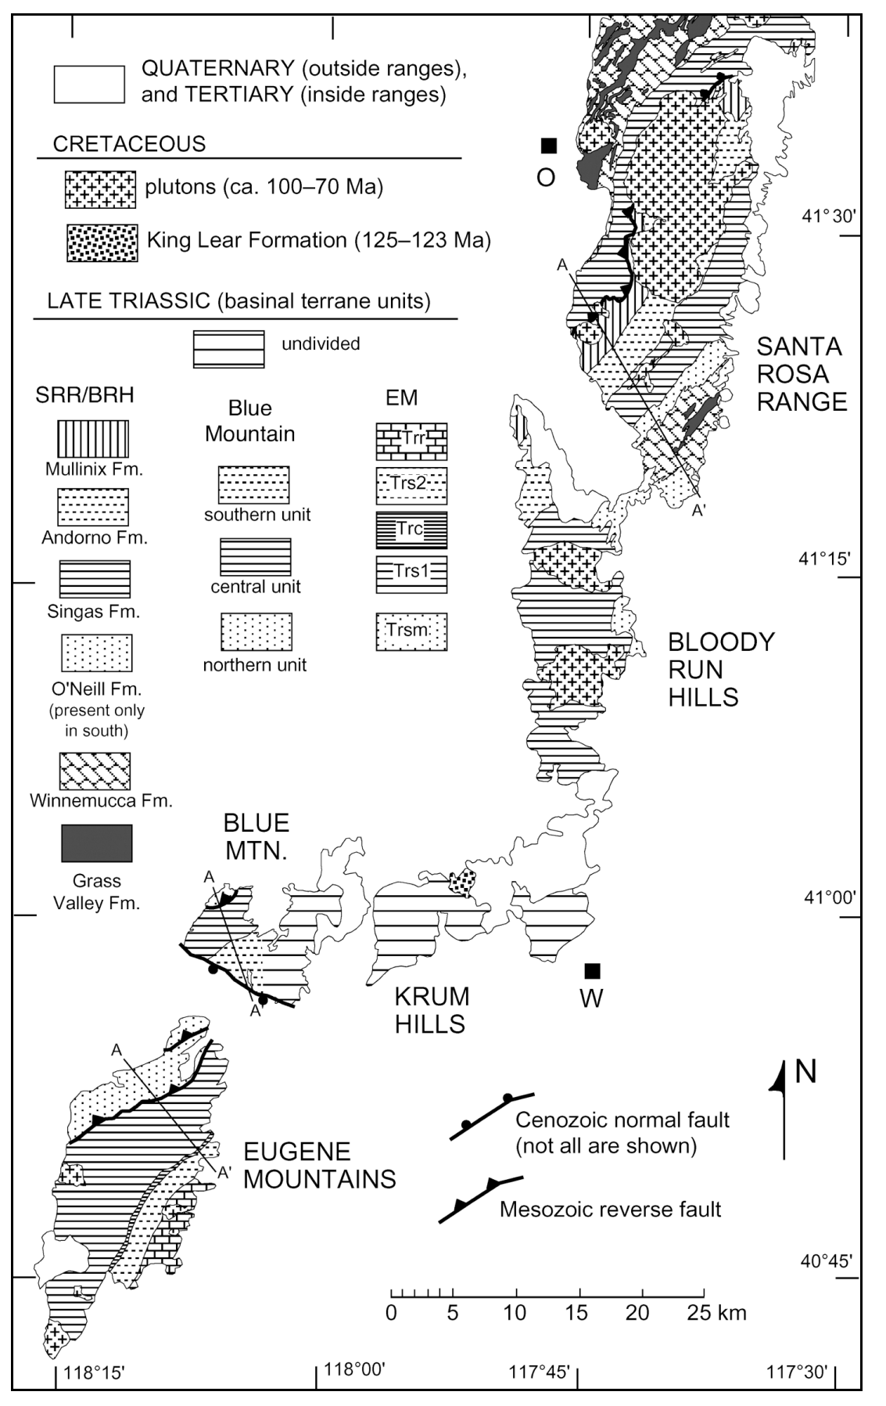
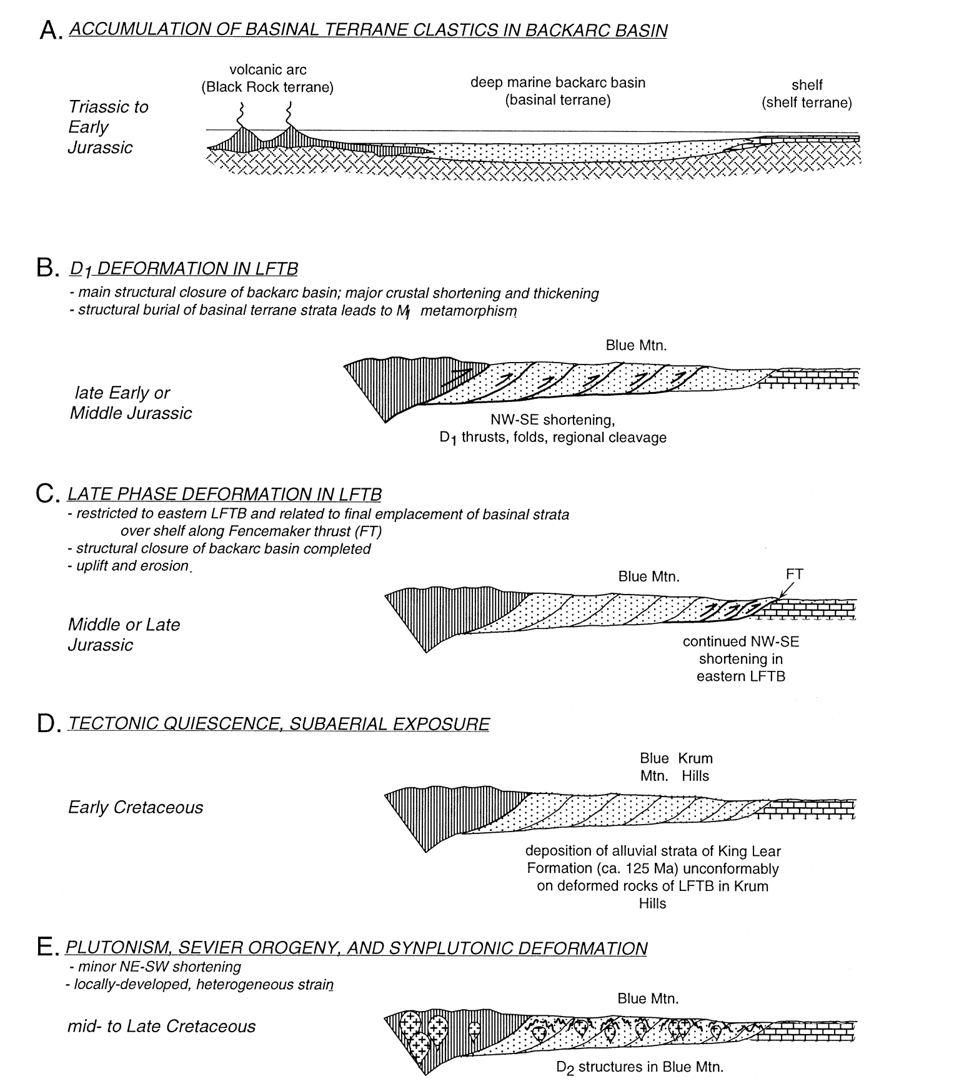
Conclusion
Stratigraphy -> mapping/field observations -> interpretation

